Slide 1
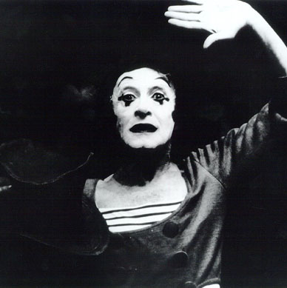
PANTOMIME !!!
Fundamentals of Theatre I

Slide 2
WHAT IS PANTOMIME?

Slide 3
What is pantomime?
TO TELL A STORY WITHOUT THE USE OF WORDS,
AN EMPHASIS ON PHYSICAL EXPRESSION.

Slide 4
Marcel Marceau 1923-2007
Cafe in Paris
and
The Tango

Slide 5
WHAT ACTING SKILLS ARE USED WHEN PERFORMING A PANTOMIME?

Slide 6
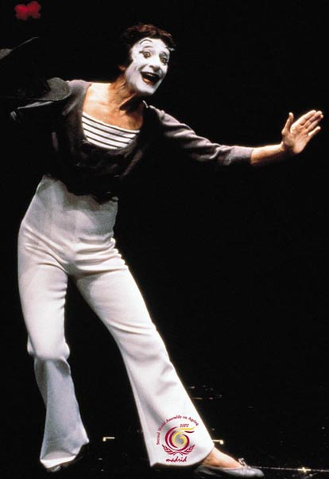
What acting skills are used when performing a pantomime ?
Creativity
Self-Discipline
Exaggeration
Creativity
Muscle Tension

Slide 7
RULES TO REMEMBER WHEN PERFORMING A PANTOMIME …
Prepare a STORY .

Slide 8
RULES TO REMEMBER WHEN PERFORMING A PANTOMIME …
Prepare a STORY .
2. EXAGGERATE your movements.

Slide 9
RULES TO REMEMBER WHEN PERFORMING A PANTOMIME …
Prepare a STORY .
2. EXAGGERATE your movements.
3. Use SLOW and exact MOVEMENTS.

Slide 10
RULES TO REMEMBER WHEN PERFORMING A PANTOMIME …
Prepare a STORY .
2. EXAGGERATE your movements.
3. Use SLOW and exact MOVEMENTS.
4. Use SPECIFIC DETAILS.

Slide 11
RULES TO REMEMBER WHEN PERFORMING A PANTOMIME …
Prepare a STORY .
2. EXAGGERATE your movements.
3. Use SLOW and exact MOVEMENTS.
4. Use SPECIFIC DETAILS.
5. Get the audience to SEE your PROPS.

Slide 12
RULES TO REMEMBER WHEN PERFORMING A PANTOMIME …
Prepare a STORY .
2. EXAGGERATE your movements.
3. Use SLOW and exact MOVEMENTS.
4. Use SPECIFIC DETAILS.
5. Get the audience to SEE your PROPS.
6. No EYE CONTACT with the audience.

Slide 13
RULES TO REMEMBER WHEN PERFORMING A PANTOMIME …
7. Stay in CHARACTER .

Slide 14
RULES TO REMEMBER WHEN PERFORMING A PANTOMIME …
7. Stay in CHARACTER .
8. Direct all MOVEMENT toward the AUDIENCE.

Slide 15
RULES TO REMEMBER WHEN PERFORMING A PANTOMIME …
7. Stay in CHARACTER .
8. Direct all MOVEMENT toward the AUDIENCE.
9.Use PHYSICAL EXPRESSION to show EMOTION of CHARACTER.

Slide 16
RULES TO REMEMBER WHEN PERFORMING A PANTOMIME …
7. Stay in CHARACTER .
8. Direct all MOVEMENT toward the AUDIENCE.
9.Use PHYSICAL EXPRESSION to show EMOTION of CHARACTER.
10. BEGIN and END each MOVEMENT.

Slide 17
RULES TO REMEMBER WHEN PERFORMING A PANTOMIME …
7. Stay in CHARACTER .
8. Direct all MOVEMENT toward the AUDIENCE.
9.Use PHYSICAL EXPRESSION to show EMOTION of CHARACTER.
10. BEGIN and END each MOVEMENT.
11. Practice with ACTUAL PROPS.

Slide 18
RULES TO REMEMBER WHEN PERFORMING A PANTOMIME …
7. Stay in CHARACTER .
8. Direct all MOVEMENT toward the AUDIENCE.
9.Use PHYSICAL EXPRESSION to show EMOTION of CHARACTER.
10. BEGIN and END each MOVEMENT.
11. Practice with ACTUAL PROPS.
12. Every MOVE is to be IMAGINED / Visualized .

Slide 19
RULES TO REMEMBER WHEN PERFORMING A PANTOMIME …
7. Stay in CHARACTER .
8. Direct all MOVEMENT toward the AUDIENCE.
9.Use PHYSICAL EXPRESSION to show EMOTION of CHARACTER.
10. BEGIN and END each MOVEMENT.
11. Practice with ACTUAL PROPS.
12. Every MOVE is to be IMAGINED / Visualized .
13. Practice MOVEMENTS in ORDER (STEPS).

Slide 20
RULES TO REMEMBER WHEN PERFORMING A PANTOMIME …
7. Stay in CHARACTER .
8. Direct all MOVEMENT toward the AUDIENCE.
9.Use PHYSICAL EXPRESSION to show EMOTION of CHARACTER.
10. BEGIN and END each MOVEMENT.
11. Practice with ACTUAL PROPS.
12. Every MOVE is to be IMAGINED / Visualized .
13. Practice MOVEMENTS in ORDER (STEPS).
14. Use TENSION to communicate.

Slide 21
Lets take a look at an example from Marcel Marceau.
The Lion Tamer

Slide 22
Pantomime Performance Reminders….
HAIR BACK
NO “SCENE”
CLOTHING APPROPRIATE & COMFORTABLE
QUITE AS AN AUDIENCE
NO DANCING TO THE MUSIC
DON’T COPY IDEAS
DON’T TALK TO IMAGINARY PEOPLE

Slide 23
Pantomime Performance Reminders …
DON’T TOUCH CLOTHES
NO PROPS
CHAIR IS OKAY
PRACTICE AND REMEMBER YOUR MUSIC
ADD DETAILS
MOVE TO THE MUSICAL BEATS (WHEN PERFORMING)

Slide 24
Pantomime Project
Part One
Time length 2-3 minutes
In this performance you will present a creative personality involved in a specific action. Create a short story around the action.
Remember to include CONFLICT, BELIEVABLE ACTION, & SPECIFIC DETAILS.

Slide 25
Pantomime Project
PART TWO
Time Length 2-3 minutes
TRAPPED IN A BOX
STAGES OF MAN
FLOWER GROWING FROM SEED
You will choose one of the pantomime assignments listed above and create and entertaining and interesting pantomime ! Don’t forget CONFLICT and SPECIFIC DETAILS !!!

